Slide 1
Statistical and Predictive Analysis for The Houston Area Living Condition
Group Member: Jin Kown, Ran Jin, Rui Qin, Tengjiao Liu, Xinran Zhou
Jan 26, 2019

Slide 2
Introduction
Goals
Explore the dataset, and the relation of the people feelings to their experiences and attitudes
Create models to summarize understanding of how living satisfaction relates to the factors
Based on the “happiness level” of living in Houston people feel to make improvement suggestions for Houston City.
Prove and employ predictive analysis that will help guide future actions and improvements

Slide 3
Data Details
Source: The Houston Area Survey on Health
Size: 1200 residents
Survey Period: 06/06/2012 - 07/17/2012
Questions: 119
Data Format: .CSV
Preprocessed: This data is preprocessed and encoded by the researches before given
Assumptions: responses are independent to each other and truly reflect the feelings

Slide 4
Pipeline
EDA
Feature Selection
Predictive Models
Suggestions

Slide 5
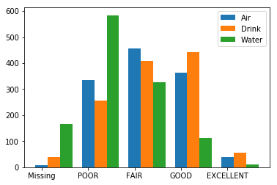
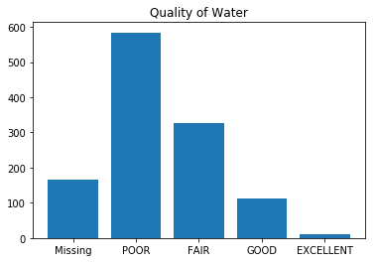
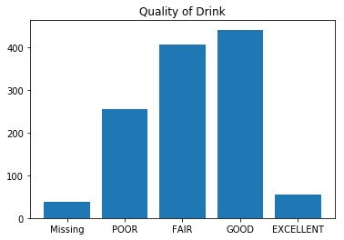
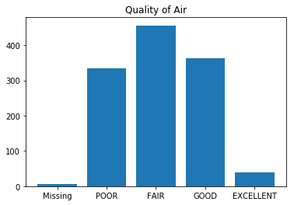
EDA

Slide 6
EDA

Slide 7
Feature Selection
Since it is a survey, we chose the features based on the survey questions
Objective
Related to this project
Features:
havinsur, sidewalks, hoodactiv, easyfood, shopshere, trailhere, buyfood, parkhere
Want to predict “happiness level” based on question “Houston”

Slide 8
Some Features Selected
Havinsur: Are you currently covered by any type of health insurance or health care plan?
Sidewalks: My neighborhood has plenty of safe and well-connected sidewalks.
Hoodactiv: I often see other people being physically active (such as walking, jogging, bicycling, playing sports) in my neighborhood.
Easyfood: I have easy access to fresh fruit and vegetables in my neighborhood.
Shopshere: Are there shops or restaurants within easy walking distance of your home?
Trailhere: Is there a hike and bike trail within a mile or so of your home?
Buyfood: How serious a problem has it been for you in the past year to pay for the groceries you need to feed your family?
Parkhere: Is there a park or play area within a mile or so of your home?

Slide 9
Predictive Models
Random Forest
Xgboost
MLPRegressor

Slide 10
Suggestions

